Slide 1
rAIsing the Bar
How Artificial Intelligence Mirrors Other Technological Leaps

Slide 2
From Slide Rules to Engineering Calculators:
A New Standard for Precision

Slide 3
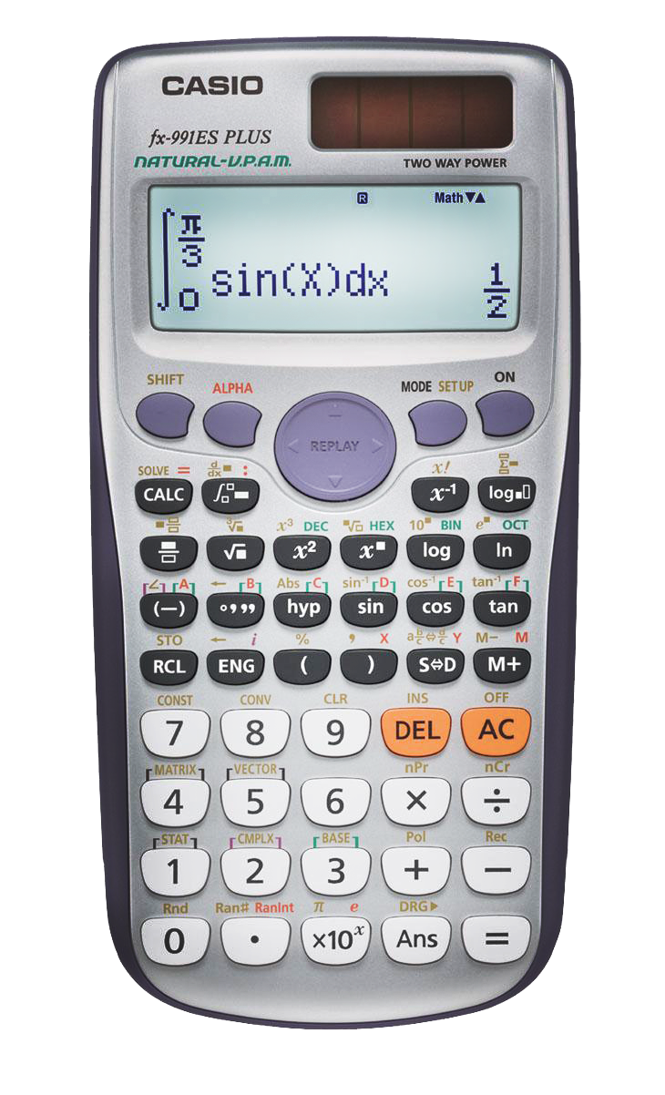
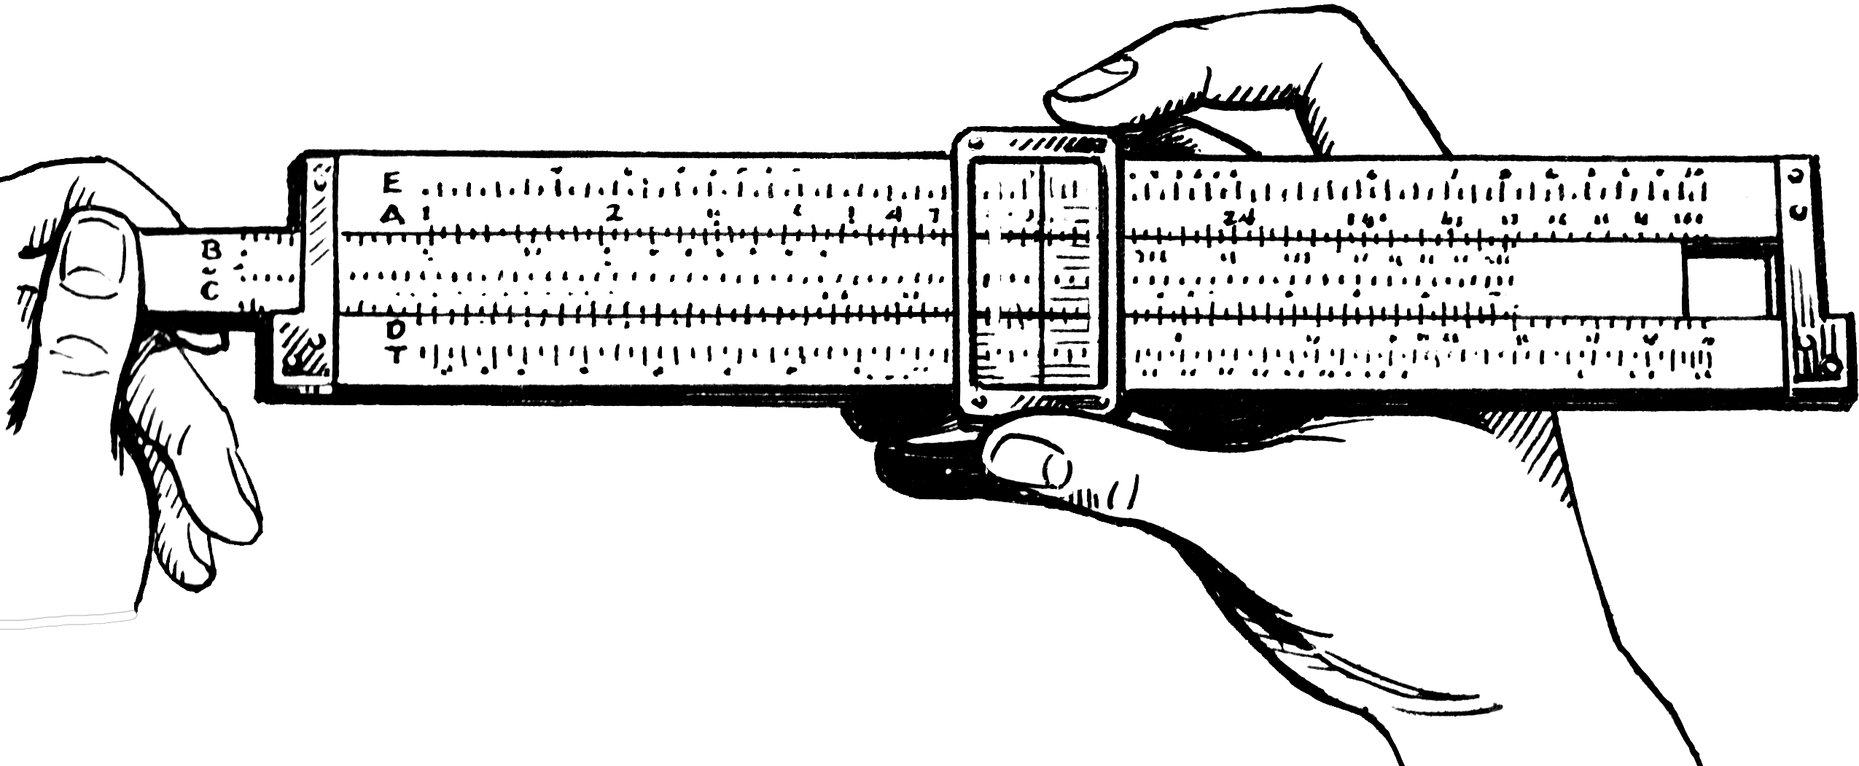
Circa 1622
Circa 1970

Slide 4
Slide Rule → Calculator
Some argued that relying on calculators could lead to a decline in fundamental mathematical understanding and problem-solving skills.
Longhand → Slide Rule
Some engineers and educators were reluctant to abandon longhand calculations and logarithm tables, arguing that reliance on the slide rule could lead to a decline in mathematical rigor.
Some educators resisted incorporating the slide rule into curricula, fearing that students would become too dependent on it rather than understanding the underlying mathematics.

Slide 5
COBOL Punch Cards to Dumb Terminals:
Efficiency Meets Higher Expectations

Slide 6
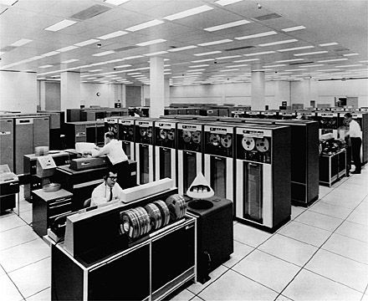
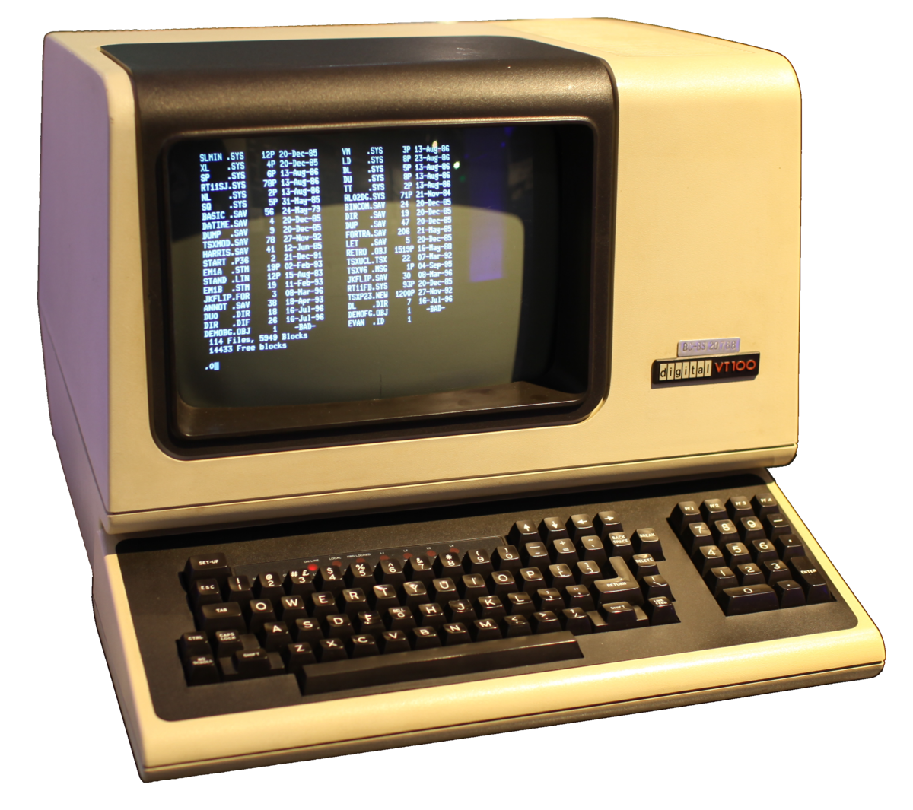
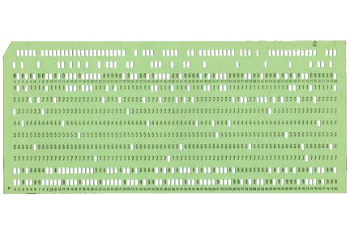

Slide 7
Dissertations:
From Typewriters to AI Tools

Slide 8
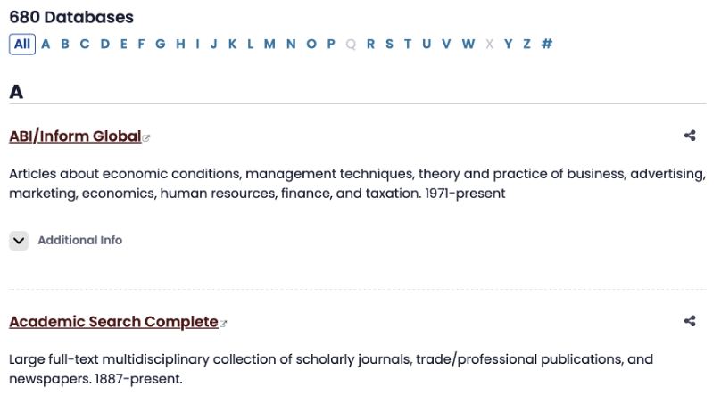
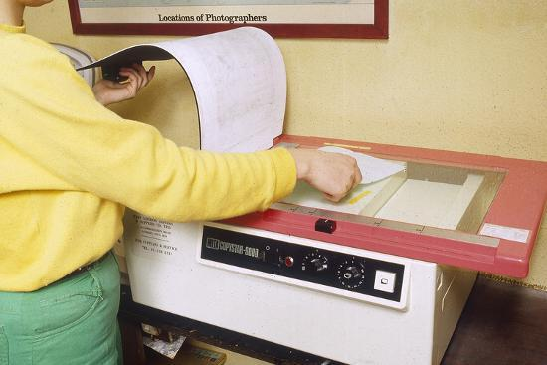

Slide 9
Re-engineering Classroom Assignments:
Simulating End-to-End Solutions

Slide 10
for row in df.itertuples():
write_rec_to_csv = ""
#acct_num
acct_num = row[1]
if pd.isna(acct_num) == False:
acct_num = str(acct_num)
acct_num = acct_num[0:4]
curr_acct_num = acct_num
else:
acct_num = curr_acct_num
#fund_code
fund_code = row[4]
if pd.isna(fund_code) == False:
fund_code = str(int(row[4]))
curr_fund_code = fund_code
else:
fund_code = curr_fund_code
#trans_info
trans_info = row[6]
if trans_info != "Beginning Balance :":
if trans_info != "Ending Balance :":
if trans_info != "Total for GL Beginning Balance:":
if trans_info != "Total for GL Changes:":
if trans_info != "Total for GL Ending Balance:":
if pd.isna(trans_info) == False:
trans_info = str(trans_info)
trans_info = trans_info.replace(' , ','::')
#trans_info = trans_info.replace(', ', ' ')
trans_info = trans_info.rstrip()
row_list.append(acct_num)
row_list.append(fund_code)
row_list.append(trans_info)
#dr_changes
dr_changes = row[7]
while lines_written < lines_to_write:
if first_pass == "N":
w = w + 4 #starting point = 2
x = x + 4 #starting point = 1
y = y + 4 #starting point = 0
z = z + 4 #starting point = 3
else:
first_pass = "N"
lines_written = lines_written + 1
#print("Lines to write: " + str(lines_to_write))
#print("Lines written: " + str(lines_written))
string_with_date = row_list.pop(w)
row_list.insert(w,string_with_date)
#print("String with date:" + string_with_date)
extracted_date = datefinder.find_dates(string_with_date,strict=True)
for match in extracted_date:
date_only = str(match)[:10]
date_only = date_only.replace("-","/")
year = date_only[:4]
day_month = date_only[-5:] + "/"
date_only = day_month + year
write_post_date = date_only
write_trans_info = row_list.pop(w)
if date_only[:1] == '0' or date_only[:1] == '1':
date_only = "::" + date_only[-10:]
str_stripped_of_date = write_trans_info.replace(date_only,"")
str_stripped_of_date = re.sub(r'(0?\d|1[0-2])/([1-2]\d|3[01]|0?\d)','',str_stripped_of_date)
strip_year = "::" + date_only[-5:]
str_stripped_of_date = re.sub(strip_year,'',str_stripped_of_date)
write_trans_info = str_stripped_of_date
row_list.insert(w,write_trans_info)
write_acct_num = row_list.pop(x)

Slide 11
Up the Game
Don’t simply create assignments that require students to write programs.
Address the biggest challenge…translating a problem into a solution.

Slide 12
Create assignments that show how to provide end-to-end solutions:
discuss client needs
gather requirements
design phase

Slide 13
Scenario 1: Discuss Client Needs
For this simulation:
I’ll play the role of the business owner who runs Reliable Solutions Plumbing.
You’ll play the role of the consultant, asking questions to understand the client’s needs, constraints, expectations, and goals for the CRM system.
Your objective is to conduct a thorough needs analysis by:
Asking clarifying questions about my plumbing business
Exploring my current customer tracking challenges
Determining my budget constraints
Understanding my timeline expectations
Identifying my technical capabilities and existing systems
Uncovering unstated needs the client might not be aware

Slide 14
Scenario 1: Discuss Client Needs
By the end of our consultation, you should aim to
have a clear understanding of what the client needs in a CRM system versus what it think it wants.
be able to propose a preliminary direction for solutions that will effectively track and enhance customer loyalty.
Start the simulation by introducing yourself as a consult and asking your first set of questions to understand my business and CRM needs.

Slide 15
Scenario 2: Gather Requirements
Your team has been assigned to document detailed functional and non-functional requirements for Reliable Solutions Plumbing’s CRM system. You’ve already learned from the initial meeting that the owner wants to:
Track customer service history
Implement a loyalty program
Improve scheduling efficiency
Generate reports on customer retention
You now need to:
Identify and categorize specific system requirements
Prioritize requirements based on business value
Document constraints and assumptions
Create user stories for key functionality
Map data relationships and system integrations

Slide 16
Scenario 2: Gather Requirements
Begin by organizing your approach to requirements gathering and drafting your first set of detailed questions or documentation templates. Develop a comprehensive requirements document by:
Creating a list of specific questions to gather missing information about:
User roles and permissions
Data fields needed for tracking customer information
Loyalty program mechanics
Reporting requirements
Integration with existing systems
Mobile vs. desktop usage needs
Documenting requirements in a structured format using clear, measurable statements

Slide 17
Scenario 2: Gather Requirements
Identifying potential challenges or conflicts in the requirements
Establishing acceptance criteria for each major feature

Slide 18
Scenario 3: Design Phase
Develop a preliminary design proposal that addresses these aspects of the CRM system. Consider the business constraints and requirements you learned during the client consultation. Be prepared to justify your design choices and demonstrate how they align with the business’s goals.
Data Architecture: What customer data will be collected and how will it be organized?
Customer profiles
Service history tracking
Loyalty metrics and indicators
User Interface: How will employees interact with the system?
Dashboard design
Key features and functionality
Mobile vs. desktop considerations

Slide 19
Scenario 3: Design Phase
Loyalty Program Integration: How will the system track and reward customer loyalty?
Points system or tiered structure
Rewards and incentives
Automated communications
Technical Implementation: What platform or technologies will you recommend?
Off-the-shelf solutions vs. custom development
Integration with existing systems (scheduling, invoicing, etc.)
Scalability considerations
Implementation Plan: What are the phases for rolling out this system?
Timeline
Training requirements
Success metrics

Slide 20
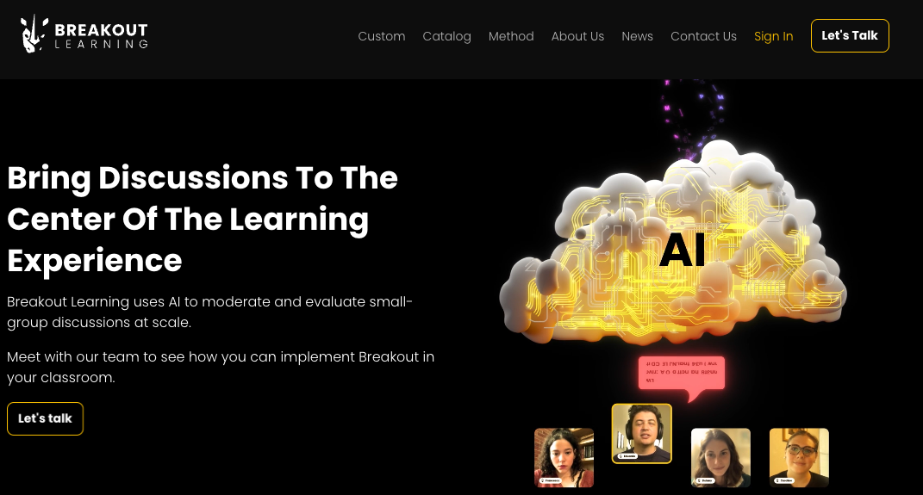

Slide 24
Thank you!
Questions?

Slide 25
Resources
Breakout Learning: https://www.breakoutlearning.com/

